Slide 1
Multi-Perspective Crowd Density Analytics via Containment-Aware NMS and Spatial Consensus
BCSP786 – Major Project Phase - II
Review - 2
Submitted By
1CR23CS127 – Pavan BR
1CR23CS060 – G Bharath Sai
1CR23CS080 – Jeevan L
Guidance of
Prof. Bibi Annie Oommen, Assistant Professor Dept. of CSE
31-08-2026

Slide 2
Outline
Problem Statement
Objective
Base Paper – Journal Paper Referencence
Progress After Review 1
Proposed Methodology
Intermediate Results

Slide 3
Problem Statement
Monitoring large public venues requires placing multiple cameras at different viewing angles. Simply adding counts from each angle causes massive double-counting of people visible in shared views.
Different camera angles create severe perspective changes and different scale variations per view. A person standing near Camera 1 appears large, but looks tiny and background-distant from Camera 2.
Occlusion varies greatly depending on the viewing angle of each specific camera. A person clearly visible from Camera Angle A can be completely hidden behind someone else in Camera Angle B.
Slicing high-resolution multi-angle camera feeds into processing tiles creates box fragmentation. Standard NMS fails across tile boundaries and splits single individuals into separate upper/lower body boxes.
Different camera perspectives frequently report conflicting count numbers for the exact same physical area. Existing systems lack a spatial consensus mechanism to resolve count disagreement and quantify uncertainty.

Slide 4
Objectives
Analyze multi-angle CCTV camera feeds using tiled inference across different viewing perspectives. This recovers small, background, and occluded individuals that are missed from a single camera angle.
Implement custom containment-aware NMS post-processing to handle bounding box fragmentation. This eliminates redundant duplicate boxes and merges split upper and lower body fragments.
Construct a downsampled binary grid occupancy mapping mechanism to evaluate spatial crowd density. This calculates exact non-overlapping occupied area without double-counting shared ground space.
Develop a spatial consensus view fusion algorithm to combine multi-perspective camera counts. This eliminates double-counting of people visible in overlapping fields of view across camera angles.

Slide 5
Novelty of Proposed System
Developed a custom containment promotion and vertical fragment merging post-processing algorithm. Unlike standard NMS, this rescues enclosed body fragments and merges split upper and lower body boxes.
Implemented a binary grid occupancy mapping mechanism paired with a dynamic reliability scoring engine. This calculates exact non-overlapping spatial ground coverage and automatically reports count uncertainty.
Designed a spatial consensus fusion model using field-of-view overlap discounting and view variance penalties. This combines multi-perspective CCTV camera feeds into a unified count without double-counting people.

Slide 6
Base Paper
Primary Base Paper: Y. Li, X. Zhang, and D. Chen, "CSRNet: Dilated Convolutional Neural Networks for Crowd Counting," IEEE CVPR/TPAMI 2022. Detection Backbone Paper: G. Jocher, A. Chaurasia, and J. Qiu, "Ultralytics YOLOv8," 2023.
Integrated Solution: CSRNet generates heatmaps without bounding boxes, while standard YOLO lacks crowd analytics and multi-camera fusion. Our system combines YOLO's person detection with spatial density theory, adding custom containment NMS and multi-camera consensus fusion.

Slide 7
Progress After Review 1
Progress Made After Review 1:
Evaluated and tested our complete pipeline across diverse real-world public crowd images from railway platforms, assemblies, and concourses.
Implemented an optimized ONNX backend executing YOLOv8 person detection efficiently on standard CPU hardware.
Review 1 Comments Addressed:
Panel Comment: Multiple people standing close together were being detected as a single combined box.
Solution: Developed custom Containment-Aware NMS and IoM suppression to separate overlapping individuals into distinct boxes.
Panel Comment: Low efficiency in detecting far-away individuals who appear very tiny in the background.
Solution: Implemented $640 \times 640$ tiled sliding window inference to magnify and recover small background targets.

Slide 8
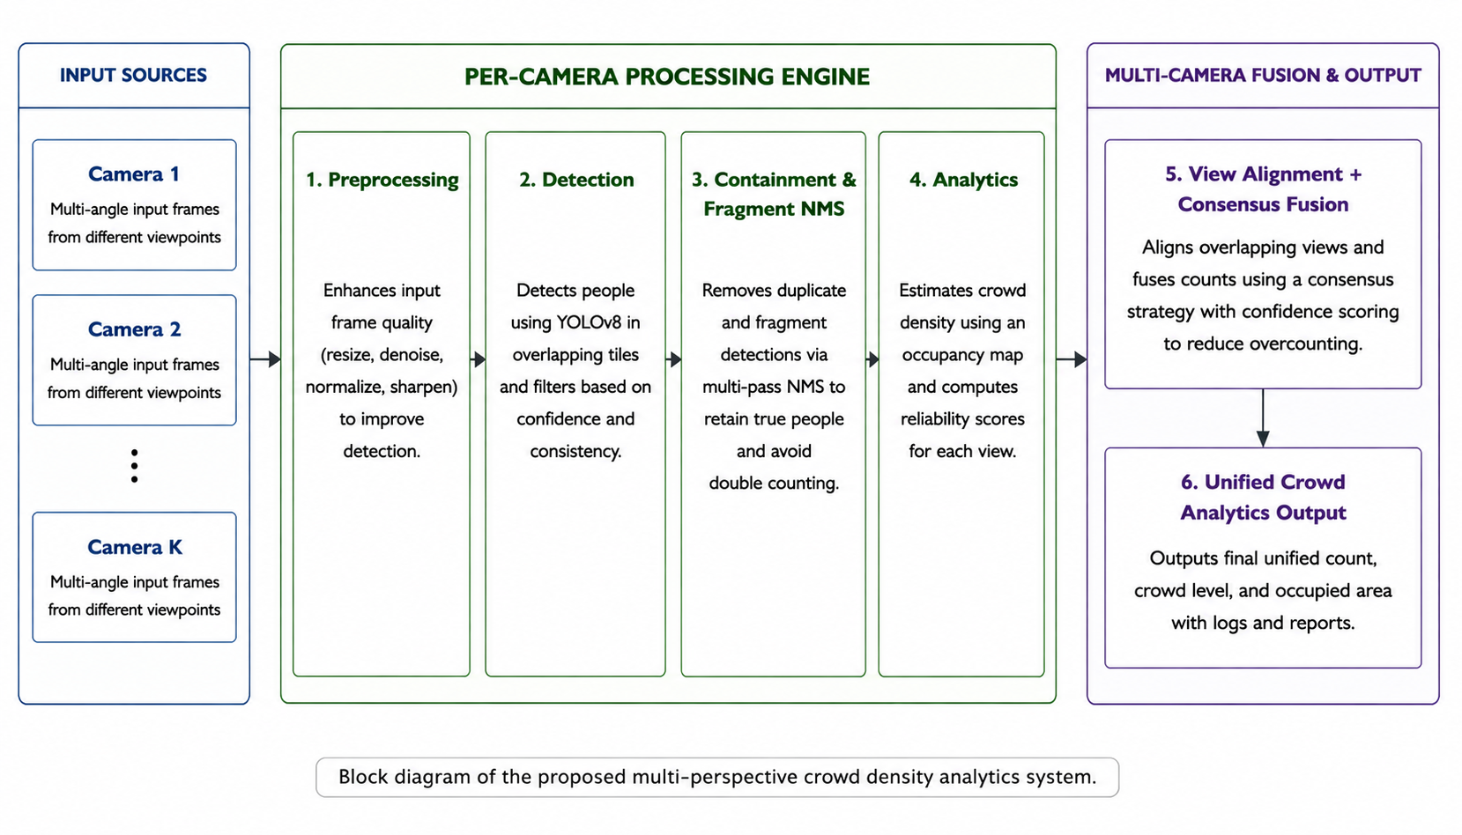
System Architecture
Block Diagram

Slide 9
Dataset Description
Sourced from PETS 2009 Multi-Camera Benchmark Dataset and Kaggle Human Crowd Dataset. Public multi-angle surveillance camera feeds and real-world high-density crowd images.
Dataset Description: High-resolution image frames captured across diverse public venues and infrastructure environments. Records cover a wide spectrum of crowd density conditions from moderate gatherings to heavy crowd surges.
Key Features & Significance: Multi-angle camera views and high-resolution occluded crowd scenes. Multi-angle feeds validate multi-camera consensus fusion, while occluded scenes validate tiled NMS detection.

Slide 10
Proposed Methodology Modules / Block Diagram of Proposed System
Data Collection & Spatial Preprocessing
Tiled Feature Detection Engine (YOLOv8)
Containment Promotion & Fragment-Aware NMS Filter
Spatial Density, UQ & Multi-Camera Consensus Fusion

Slide 11
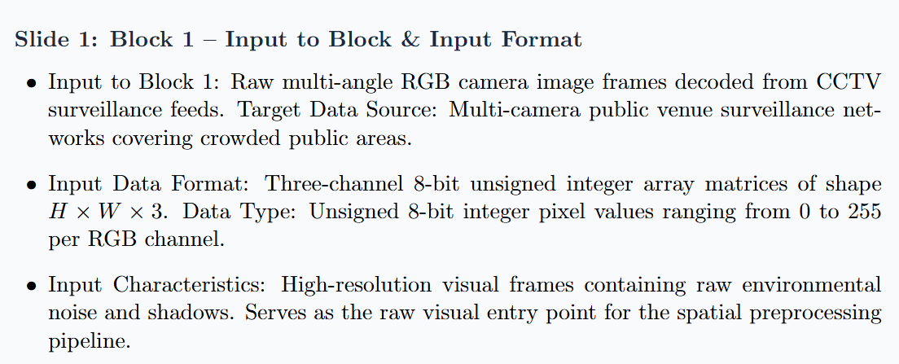
Module 1/Block 1:

Slide 12
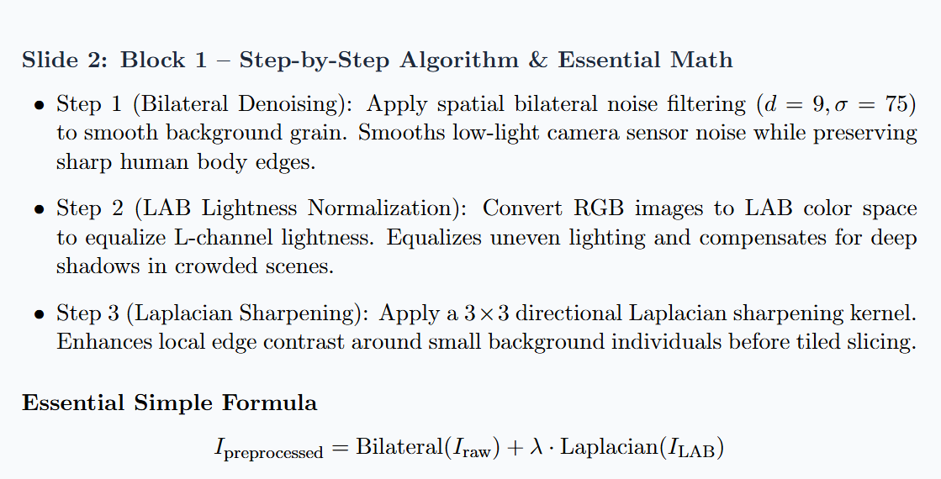
cont..

Slide 13
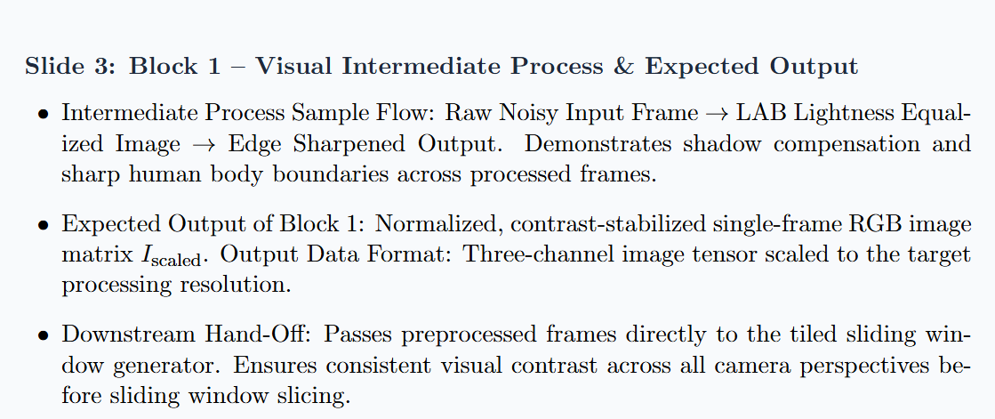
cont..

Slide 14
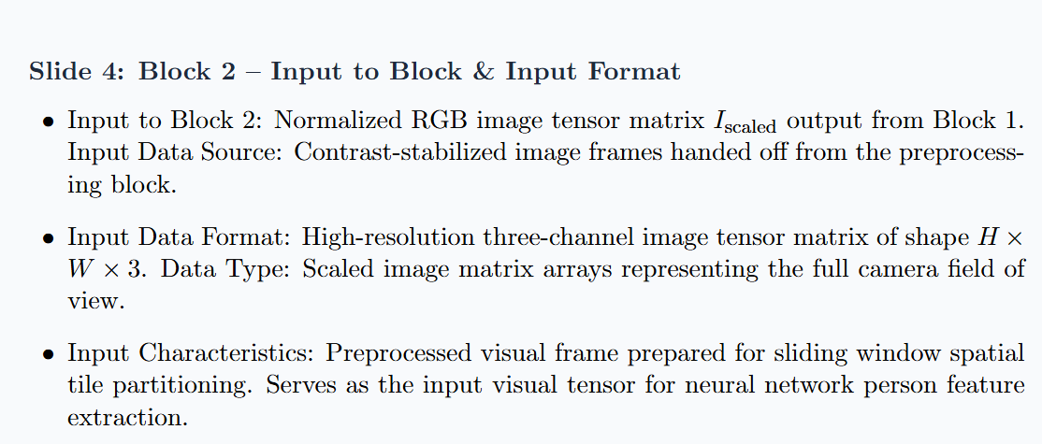
Module 2/Block 2:

Slide 15
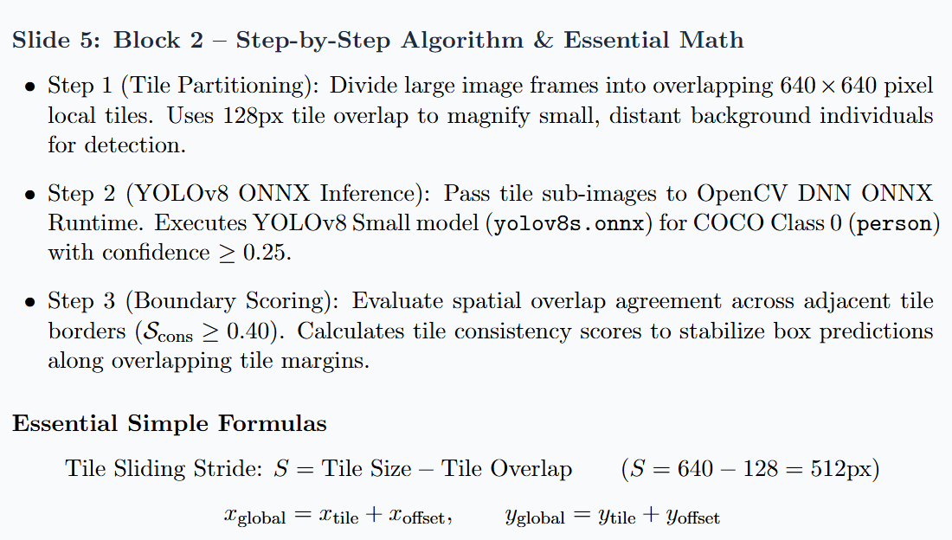
conti..

Slide 16
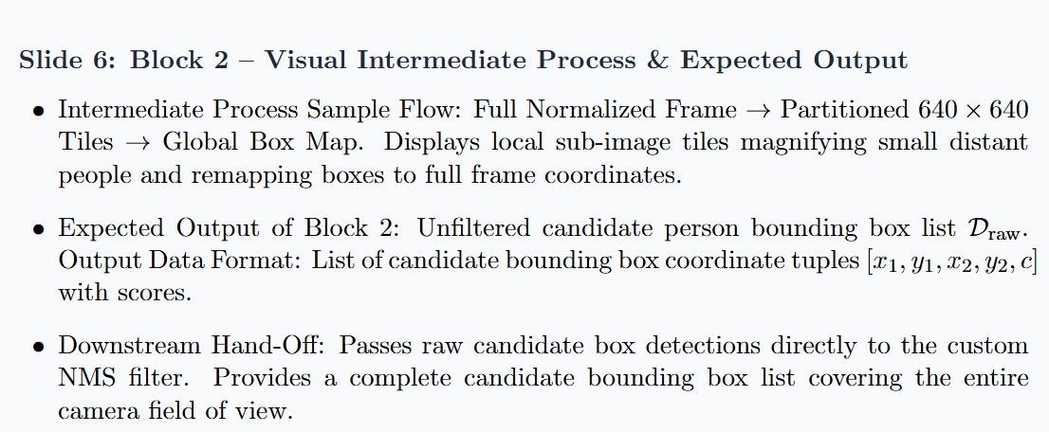
conti..

Slide 17
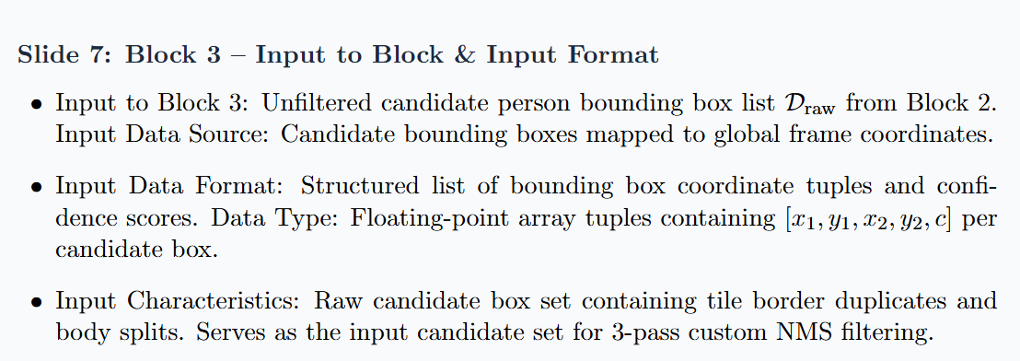
Module 3/Block 3:

Slide 18
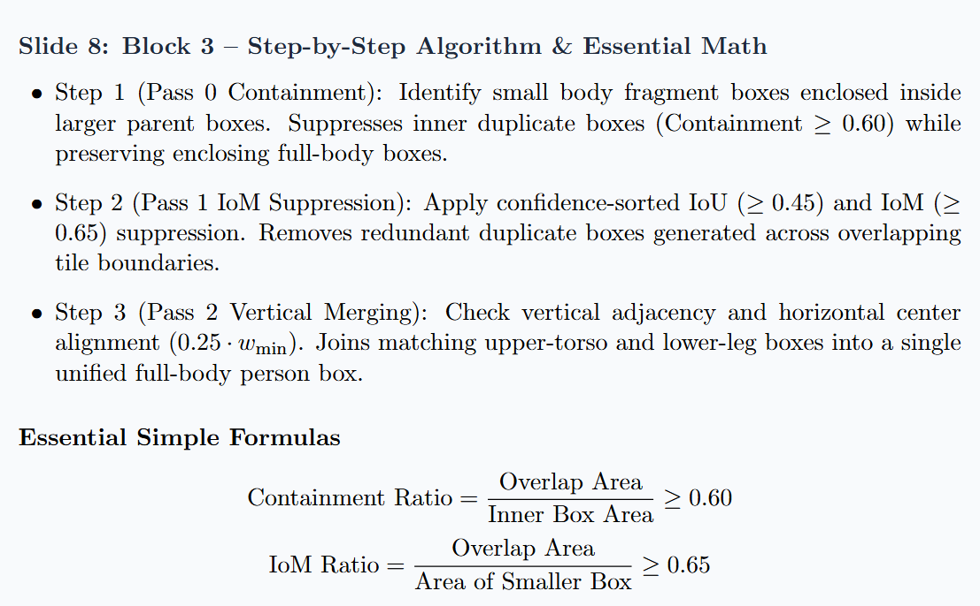
cont..

Slide 19
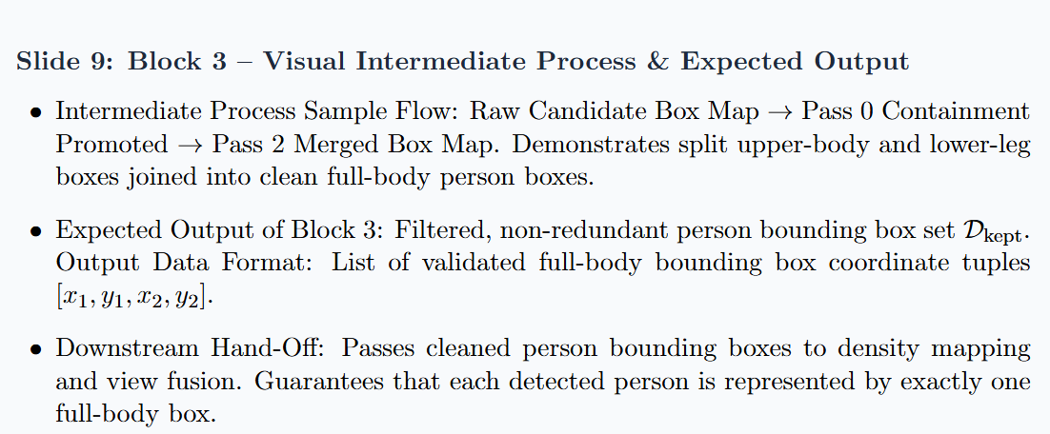
cont..

Slide 20
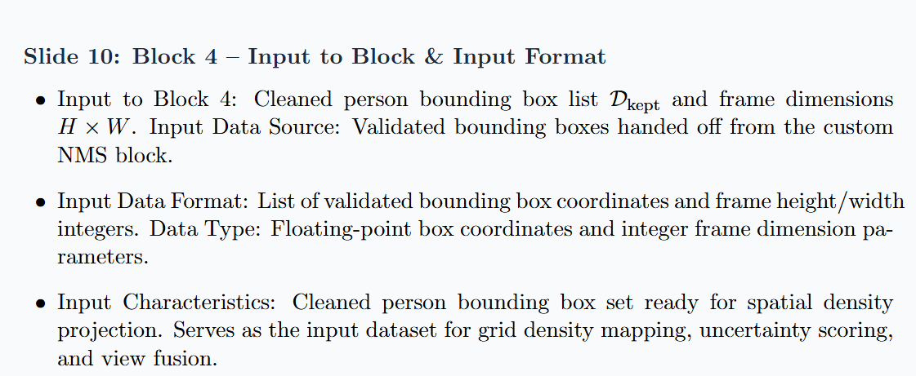
Module 4/Block 4:

Slide 21
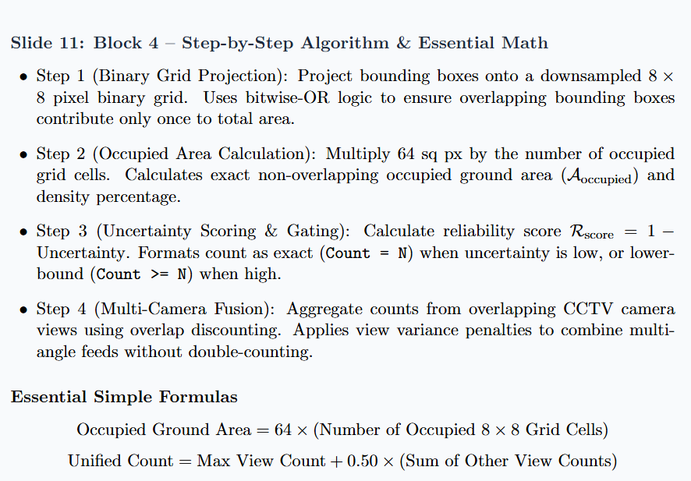
cont..

Slide 22
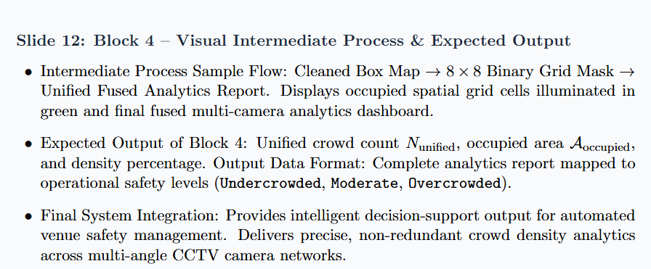
conti…

Slide 23
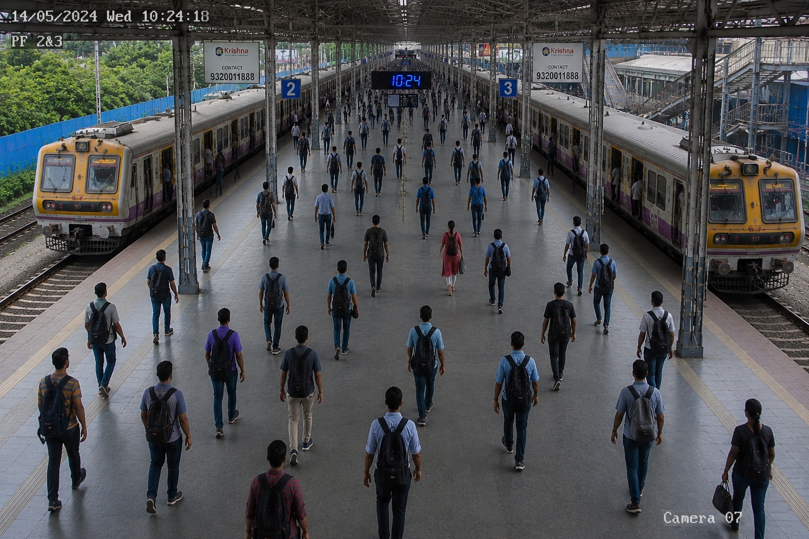
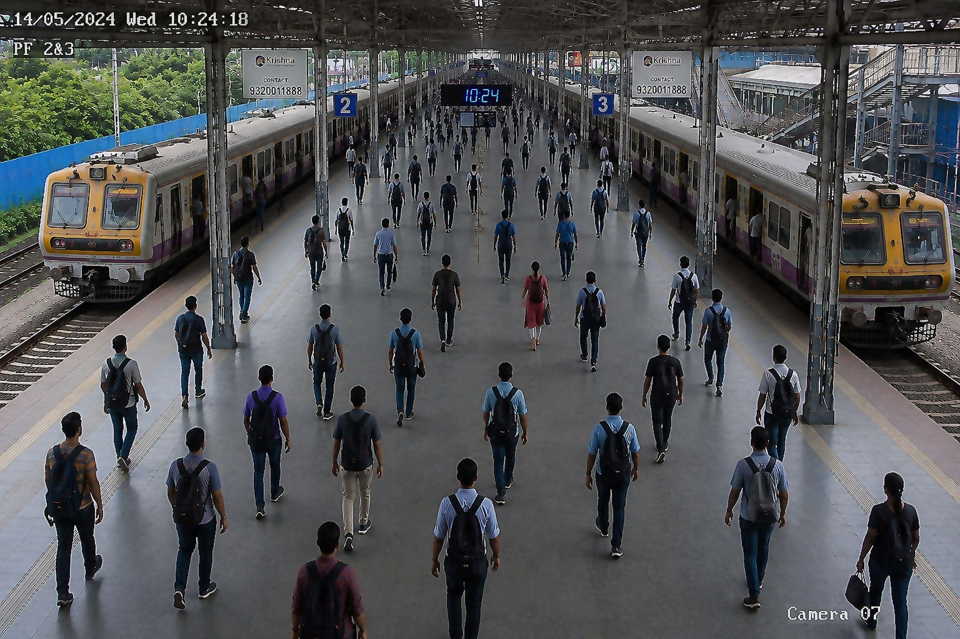
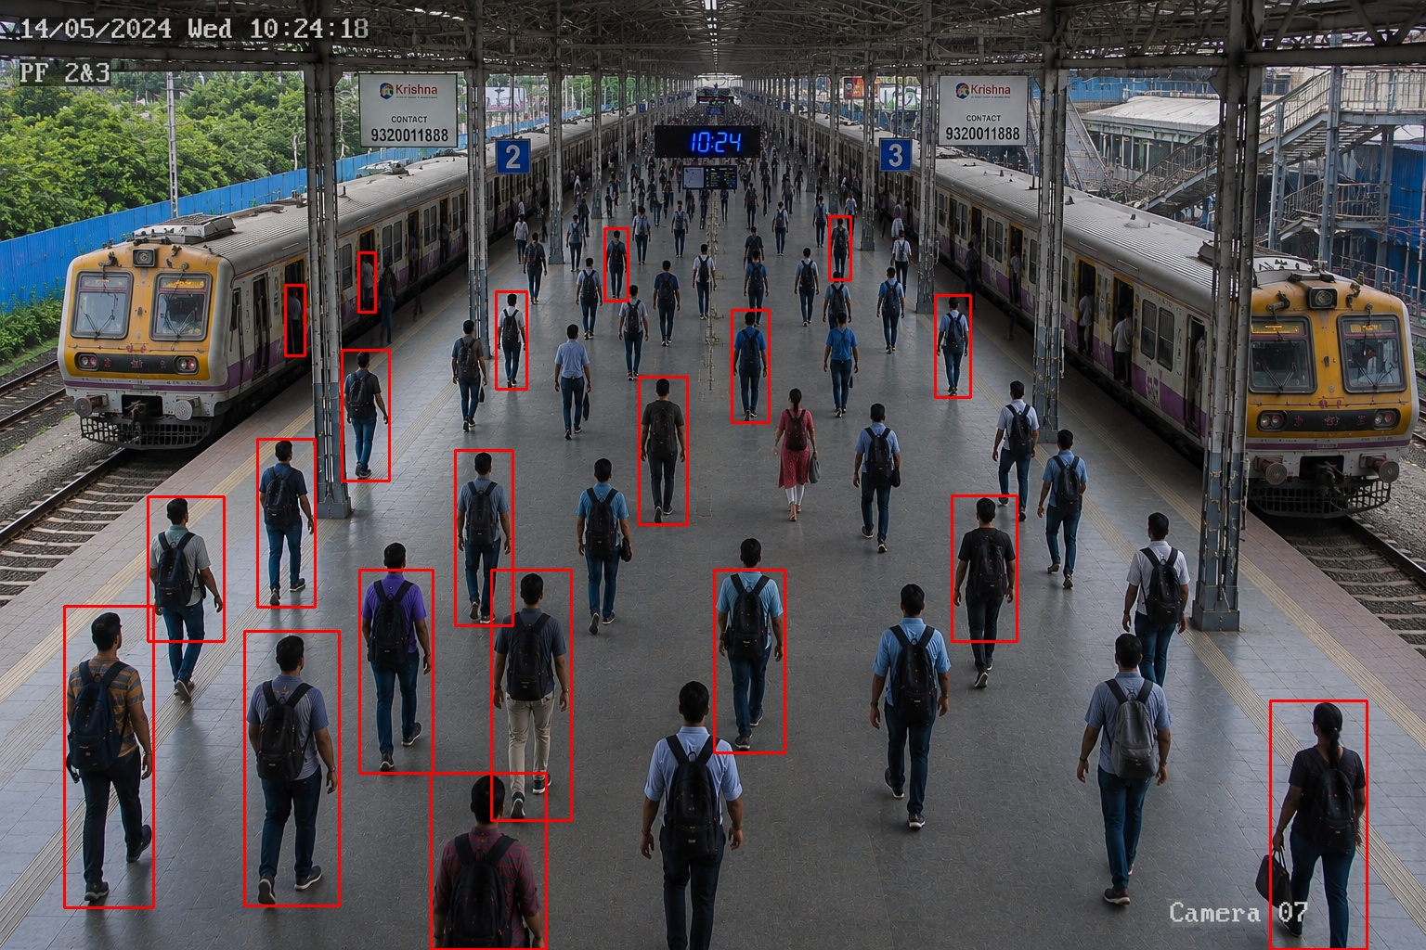
Intermediate Output Screenshots
1.input
2.preprocessed
3.before custom NMS

Slide 24
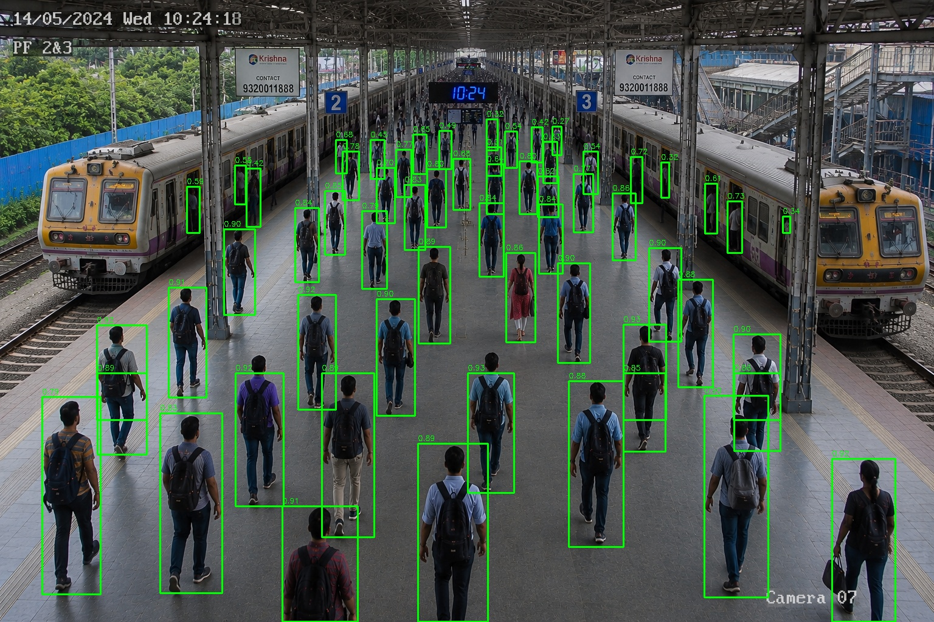
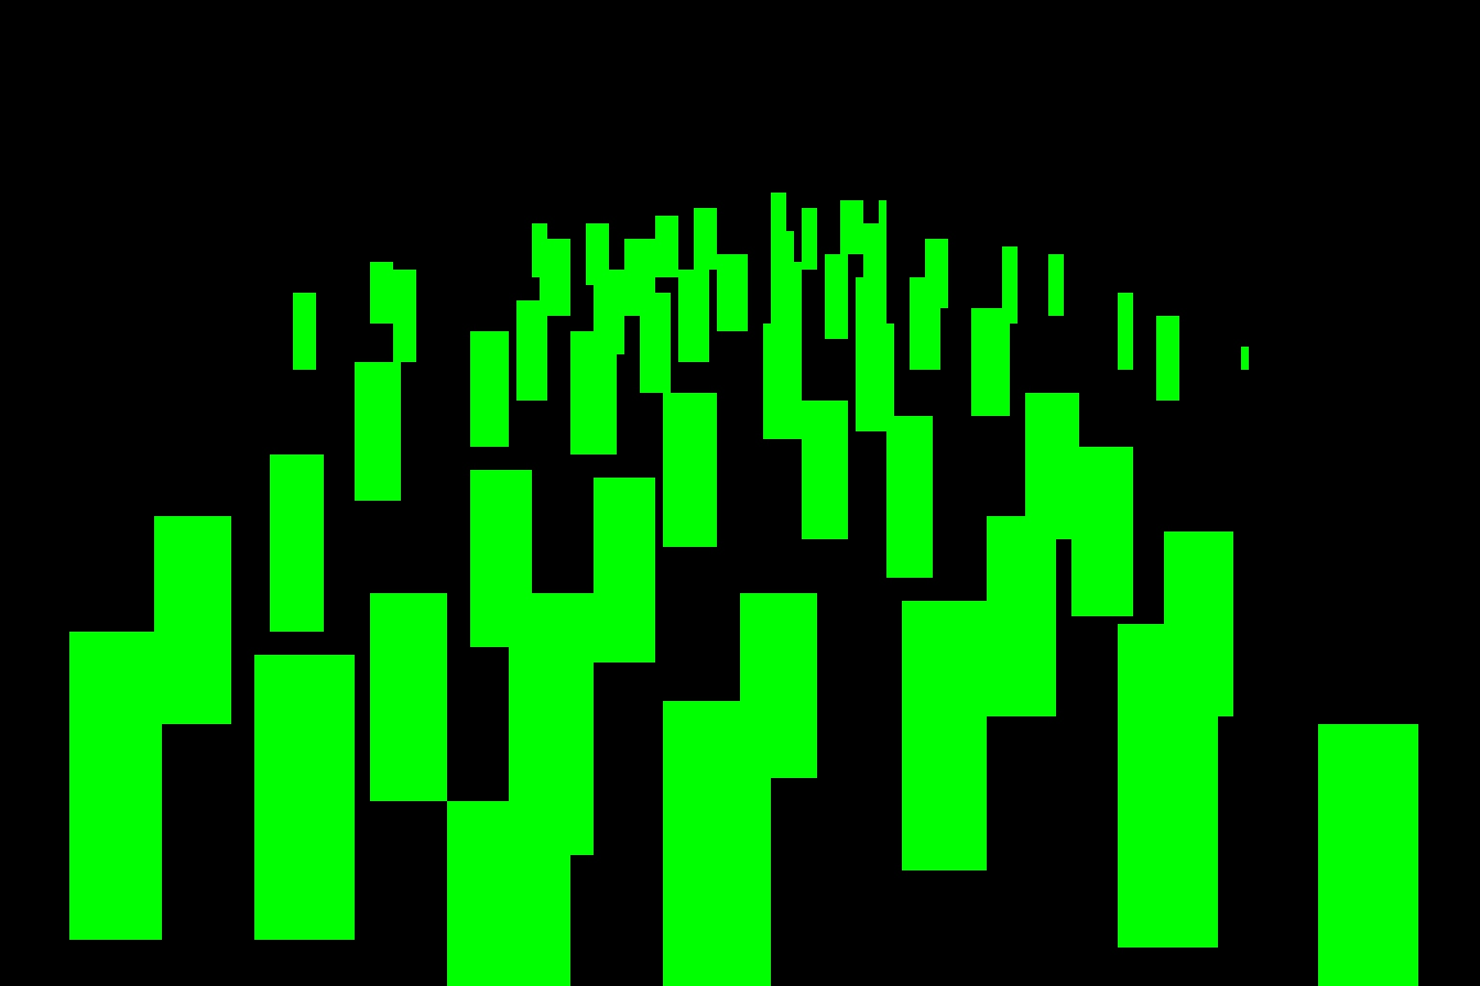
conti..
4.after custom NMS
5. Binary occupation

Slide 25
Conclusion & Future Enhancements
Conclusion:
Successfully developed an end-to-end multi-perspective crowd density analytics framework operating on standard hardware.
Our system resolves split body boxes, measures non-overlapping spatial density, and unifies multi-camera feeds cleanly.
Future Enhancements:
Extend the framework from still images to continuous real-time RTSP video streaming from live CCTV camera networks.
Optimize processing speed using GPU hardware acceleration to achieve high-frame-rate real-time performance.
Implement cross-frame temporal tracking to maintain person identities and movement vectors across video feeds.

Slide 26
References
[1] G. Jocher, A. Chaurasia, and J. Qiu, “Ultralytics YOLOv8,” version 8.0.0, 2023. [Online]. Available: https://github.com/ultralytics/ultralytics
[2] F. C. Akyon, S. O. Altinuc, and A. Temizel, “Slicing Aided Hyper Inference for Small Object Detection,” in Proc. IEEE Int. Conf. Image Process. (ICIP), 2022, pp. 966–970, DOI: 10.1109/ICIP46576.2022.9897990.
[3] Y. Li, X. Zhang, and D. Chen, “CSRNet: Dilated Convolutional Neural Networks for Crowd Counting,” in Proc. IEEE/CVF Conf. Comput. Vis. Pattern Recognit. (CVPR), 2018, pp. 1091–1100, DOI: 10.1109/CVPR.2018.00120.

Slide 27
cont..
[4] P. Shrivastav and V. Rani J., “A Real-Time Crowd Detection and Monitoring System using Machine Learning,” in Proc. IEEE IDCIoT, 2023, pp. 383–388, DOI: 10.1109/IDCIoT56793.2023.10053517.
[5] P. Shrivastav and A. K. Thavani Andu, “Integrated Approach for Real-time Human Counting, Tracking, and Direction Estimation,” in Proc. IEEE ICCCNT, 2024, pp. 2709–2714, DOI: 10.1109/ICCCNT61001.2024.10726257.
[6] P. Shrivastav, “Advancements and Challenges in Low-Light Object Detection,” in Proc. IEEE IDCIoT, 2024, pp. 1351–1356, DOI: 10.1109/IDCIoT59759.2024.10467669.

Slide 28
cont..
7] N. Bodla, B. Singh, R. Chellappa, and L. S. Davis, “Soft-NMS -- Improving Object Detection With One Line of Code,” in Proc. IEEE Int. Conf. Comput. Vis. (ICCV), 2017, pp. 5561–5569, DOI: 10.1109/ICCV.2017.593.
[8] C. Xu, K. Kang, and X. Wang, “Multi-view Crowd Counting via Spatial Transform,” in Proc. IEEE/CVF Int. Conf. Comput. Vis. (ICCV), 2019, pp. 8198–8207, DOI: 10.1109/ICCV.2019.00829.
[9] Z. Ma, X. Wei, X. Hong, and Y. Gong, “Bayesian Loss for Crowd Count Estimation With Point Supervision,” in Proc. IEEE/CVF Int. Conf. Comput. Vis. (ICCV), 2019, pp. 6142–6151, DOI: 10.1109/ICCV.2019.00624.

Slide 29
THANK YOU

